Slide 1
SysEng 5211 Computational Intelligence
Steven Corns
Numerical Optimization

Slide 2
Evolutionary Computation
Mimics natural selection
Solutions represented as chromosomes
Best solutions are kept and bad ones are disposed of

Slide 3
Mid-Term
Three questions
One hour in class
Distance students can check out the exam any time after class until an hour before the next class starts

Slide 4
Fuzzy Set Theory
Focuses on nonstatistical uncertainty, not to be confused with statistical uncertainty
Based on set theory and partial memberships

Slide 5
Neural Networks
Mimics neurons in the brain
Creates a parallel architecture of simple computational devices

Slide 6
Applications of CI
Bioinformatics/Biomedical
Manufacturing
Logistics
Power/Electrical/Utilities
Security
Games

Slide 7
Numerical Optimization
Many problems involve numerical ‘optimization’
Minimization vs. Maximization
Can this be done with a sign change?
Local vs. global
Bounded or unbounded problem
Multiple Objectives

Slide 8
Numerical Optimization
Problems can be:
Binary
Discrete
Real-valued
Mixture

Slide 9
Binary Optimization
Problems representation often involve selection of components/options
Evolutionary Computation – binary encoding
Fuzzy Systems – defuzzification to binary
Neural Network – threshold activation function

Slide 10
Discrete Optimization
Problems representation often involve selection of indivisible units
Evolutionary Computation – integer encoding, use of ‘mod’ function
Fuzzy Systems – defuzzification to integer
Neural Network – rounded or concatenated values from real activation function

Slide 11
Problem representation
Genetic Algorithm with gray coding
Successive values differ by one bit:
Value | Binary | Gray code | Value | Binary | Gray code
0 | 0000 | 0000 | 8 | 1000 | 1100
1 | 0001 | 0001 | 9 | 1001 | 1101
2 | 0010 | 0011 | 10 | 1010 | 1111
3 | 0011 | 0010 | 11 | 1011 | 1110
4 | 0100 | 0110 | 12 | 1100 | 1010
5 | 0101 | 0111 | 13 | 1101 | 1011
6 | 0110 | 0101 | 14 | 1110 | 1001
7 | 0111 | 0100 | 15 | 1111 | 1000

Slide 12
Real Valued Optimization
Problems representation often involve optimization of systems such as engineering designs
Evolutionary Computation – real value encoding, use of continuous value mutation
Fuzzy Systems – defuzzification to integer
Neural Network – direct values from real activation function (e.g. sigmoid function)

Slide 13
Real Valued Optimization
Evolutionary Optimization is often selected for real valued functions
No Free Lunch Theorem
Shares most of the standard operators, but mutation is normally done differently
E.G. Sample from a Gaussian
Uniform (highly disruptive)

Slide 14
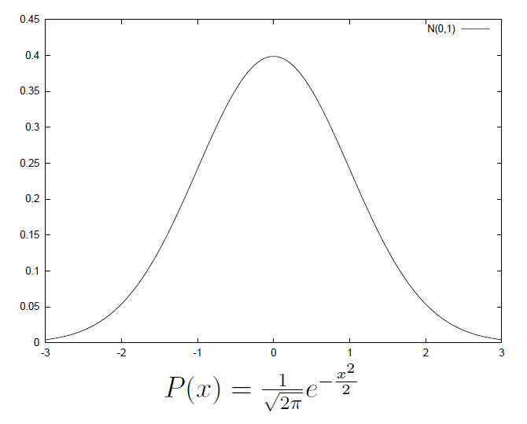
Gaussian Distribution

Slide 15
Stopping Criteria
Continuous values make it nearly impossible to ‘find’ the optima
Stopping criteria usually includes a tolerance

Slide 16
Approach
Select a fitness function
Create a population (select size)
Select crossover and mutation operators
Model the system
Set stopping criteria

Slide 17
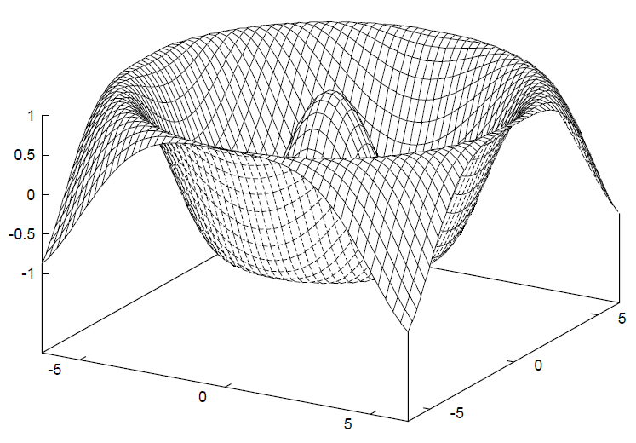
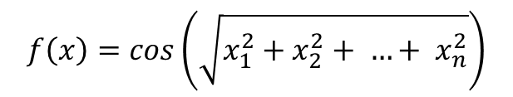
Example
We will examine a multi-dimensional ‘sombrero’.
$$f\left(x\right)=cos\left(\sqrt{x_{1}^{2}+x_{2}^{2}+ …+ x_{n}^{2}}\right)$$

Slide 18
Approach
How are you representing the population?
Binary (e.g. -2048 ≤ x ≤ 2048 for l = 12)
-2.048 ≤ x ≤ 2.048?
-20.48 ≤ x ≤ 20.48?
Real-value
How many decimal places?
Range?

Slide 19
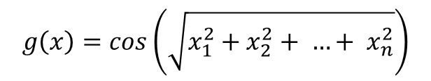
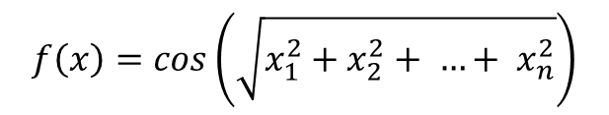
Approach
Select a fitness function
Fitness landscape
Fitness space transformation
$$f\left(x\right)=cos\left(\sqrt{x_{1}^{2}+x_{2}^{2}+ …+ x_{n}^{2}}\right)$$
$$g\left(x\right)=cos\left(\sqrt{x_{1}^{2}+x_{2}^{2}+ …+ x_{n}^{2}}\right)$$

Slide 20
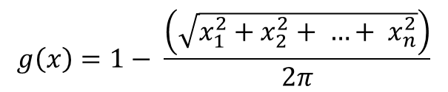
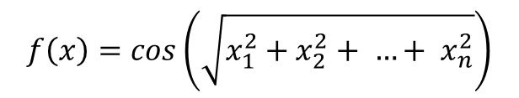
Sombrero Function
Select a fitness transformation to maximize:
Since cos(0)=cos(2π)=cos(4π)…
Minimize g(x)
$$f\left(x\right)=cos\left(\sqrt{x_{1}^{2}+x_{2}^{2}+ …+ x_{n}^{2}}\right)$$
$$g\left(x\right)=1− \frac{\left(\sqrt{x_{1}^{2}+x_{2}^{2}+ …+ x_{n}^{2}}\right)}{2π}$$
This removes the origin!

Slide 21

Sombrero Function
Or, if we just need one answer,
Minimize g(x)
What if population ranges from:
0 ≤ x ≤ 2 π?
$g\left(x\right)=$ $\sqrt{x_{1}^{2}+x_{2}^{2}+ …+ x_{n}^{2}}$

Slide 22
Population
Create a population (select size)
How large does the population need to be?
-6.4 ≤ x ≤ 6.4
If binary, there are 2⁷ (128) possible population members
Is there any benefit to having a population size of more than 128?

Slide 23
Operators
Select crossover and mutation operators
Choice of representation will impact disruptiveness of operators

Slide 24
Modeling
Model the system
Create the system in the desired platform
Integrate the different parameters

Slide 25
Stopping Criteria
Set stopping criteria
When the ‘right’ answer is found
When a solution is found within tolerance
When the population has converged to a solution
When no change has occurred in the population for ‘x’ number of iterations

Slide 26
Approach
Doing a postmortem
Did you find a solution?
Was the performance what you expected?
Why did it act like …?
What are your options?

Slide 27
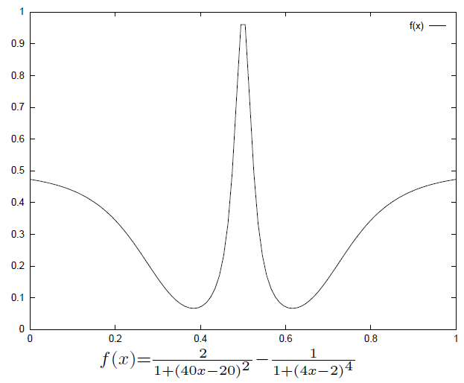
Deceptiveness and problem representation

Slide 28
Deceptiveness and problem representation
Can a binary representation find the actual optimal solution?
How long will a real-valued optimizer take to find the answer?

Slide 29
Moving Forward
Next week:
Supervised and unsupervised learning

Slide 30
Program Completed
Missouri University of Science & Technology
© 2003 Curators of University of Missouri

